Slide 1
National Hydrogen Regulatory review
Industry consultation November 2022
DCCEEW.gov.au

Slide 3
Regulatory Review - Overview

Slide 4
NHS Actions
Regulatory Review Working Group
Outputs to achieve NHS outcomes
Each jurisdiction to complete comprehensive review
Stage 1: Common Review Framework
Legislative reform to achieve:
4.1
1
Six ‘model’ hydrogen projects identified
Improved hydrogen safety and consistency of safety requirements
Improved efficiency and transparency of regulatory approvalss
Ensure international competiveness and consistency where appropriate
Be adaptive to rapid technological change and innovation to rapid technological change and innovation
Outcomes of review to be coordinated nationally
4.2
amend/draft new legislation where needed
2
Project sub-activities identified
4.3
4.4
National regulatory consistency
3
Regulation mapped against project activities
4
Individual jurisdictional reviews using common framework

Slide 5

National view of regulatory reform
Improved regulatory outcomes can be achieved where a systems view of the regulatory framework is taken. We can avoid:
  Unintended consequences
  Duplication, and more easily identify
  Areas amenable to a nationally consistent approach
Is harmonisation, where available,
always the best option*?
*all other things being equal and harmonisation is able to be achieved, in a timely manner, and without any
additional regulatory burden.
(and yes, if you’re wondering, they are not people, they are the colours of the harmony hydrogen rainbow)

Slide 6

The Benefits of a Systems-Wide Approach
Example
potential regulatory gap: there is no regulated fuel quality standard for hydrogen when used in motor vehicles as a fuel.
The closest (what would appear to be) analogous legislation that regulates other fuels is the Fuel Quality Act (Cth). Hydrogen does currently not come within its purpose in regulation - that is decreasing emissions from fuels combusted in vehicle engines.
Within a systems approach, we can then consider:
  Do we need to regulate emissions from hydrogen as a vehicle fuel?
  Are we regulating it for the same reasons/purpose for which the Fuel Quality Act (Cth) currently regulates?
  If not, is amending the Fuel Quality Act the best place to regulate?
  Are there other regulatory frameworks that may be appropriate and adapted to regulate for the required purpose that can streamline regulatory requirements for hydrogen?

Slide 7
Review outcomes – the regulatory perspective

Slide 8
Examples of State and Territory and Commonwealth legislative instruments identified as barrier/issue
States and territories
Commonwealth
Marine safety for hydrogen fuel celled vessels;
Vehicle standards for hydrogen fuel celled cars;
Fuel quality standards;
Trade measurement regulation;
Domestic fuel security;
Emissions accounting.
Major Hazard Facility thresholds as they relate to the broad spectrum of contexts of hydrogen production facilities, eg small, medium and large scale production
Pipeline safety regulation
Model legislation, regulations and code on the transport of dangerous goods
Model national heavy vehicle law.
Planning and environment laws as they relate to refuelling and hydrogen production facilities
Appliance approvals

Slide 9
After identifying the problem, what are the regulatory tools available to help fix it?

Slide 10
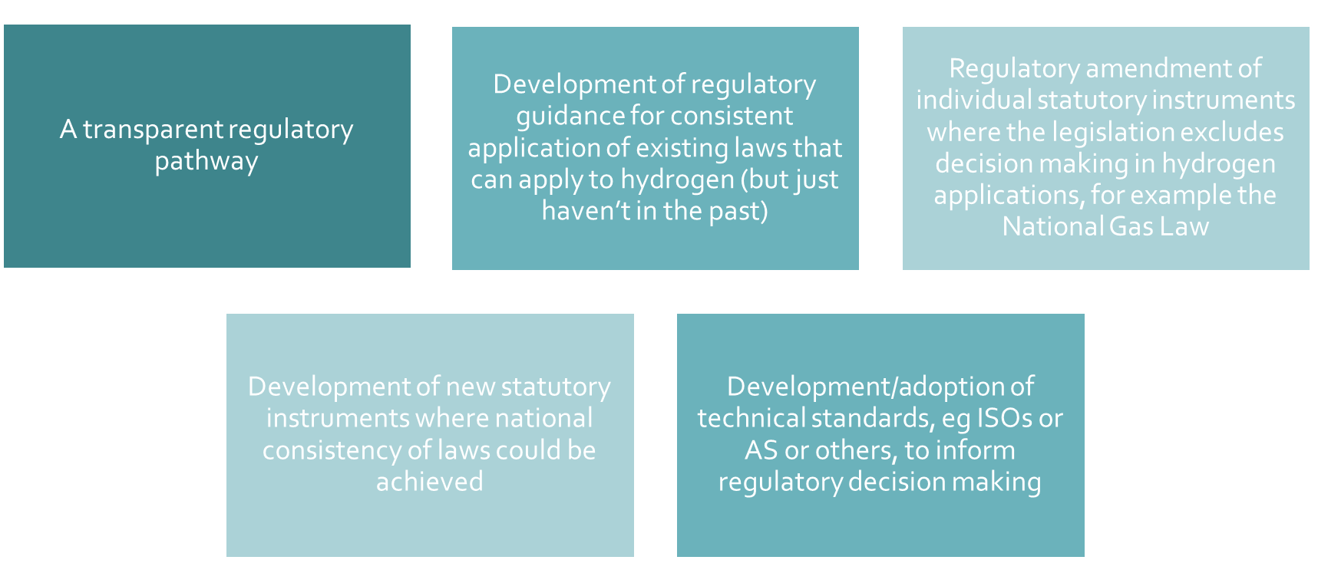

Slide 11
Roads leading to Rome
If you add a lot of little regulatory reform up, do you get to zero faster?
We want to hear from you so that we can have a world leading, hydrogen best practice regulatory framework that meets industry needs.
Link to survey
Regulatory efficiency
Quicker speed to market/scale for the H2industry
Increased investment into the H2 industry
Quicker path to Net Zero
Increased business certainty
Decreased cost for business and govts

Slide 12
Name: Hydrogen Regulatory Review
A joint initiative of the Commonwealth and all state and territory energy ministers
email: hydrogenregulatoryreview@industry.gov.au
DCCEEW.gov.au

